Slide 1


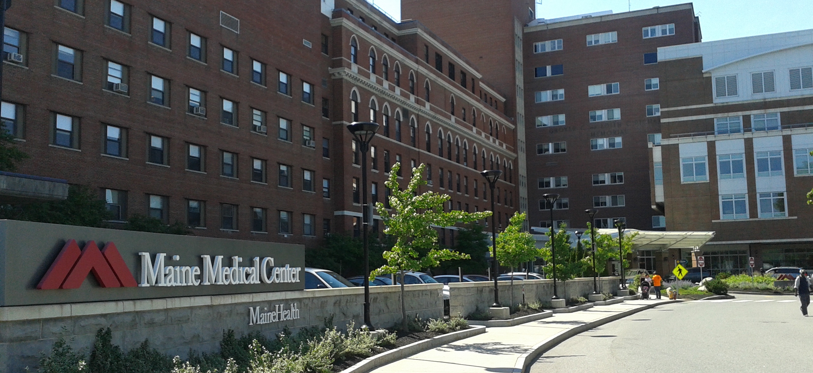
MAINEHEALTH INSIGHT SLIDES

Slide 2
Estimated Plan Growth Potential
Total Employees at Companies with 50+ Employees
(Excluding Health System Employees)
Self Funded
273K
13,550
PLAN GROWTH POTENTIAL
548K
Insured
4,275
14,325
42,475
8,548
5,200
Working Age
798K
16,525
31,500
6,625
15,150
9,175
13,500
27,425
13,000
1,367K
124,750
Population
36,500
Number of Employees
25,000
100,000

Slide 3

State-wide Plan Size
Control
Transformation
$
Margin
$
Volume/Profit
Steerage to MaineHealth
Beneficial Pricing

Slide 4
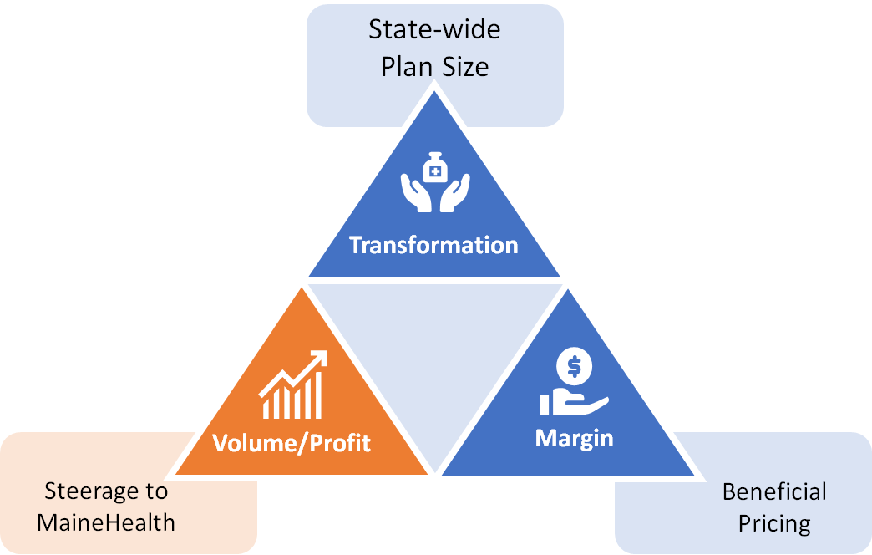
Traditional Volume-Based DTE
Year | Target Employees | Target Members
1 | 500 | 900
2 | 1,000 | 1,800
3 | 1,700 | 3,100
4 | 2,500 | 4,500
5 | 3,700 | 6,700
6 | 5,200 | 9,400
7 | 7,100 | 12,800
8 | 9,400 | 16,900
9 | 12,300 | 22,100
10 | 15,800 | 28,400
11 | 19,700 | 35,500
12 | 24,100 | 43,400
13 | 28,600 | 51,500
14 | 33,300 | 59,900
15 | 37,700 | 67,900
16 | 41,700 | 75,100
17 | 45,100 | 81,200
18 | 48,000 | 86,400
19 | 50,400 | 90,700
20 | 52,200 | 94,000
21 | 53,600 | 96,500
22 | 54,600 | 98,300
23 | 55,400 | 99,700
24 | 56,000 | 100,800
25 | 56,400 | 101,500
Early Stage
Gaining Name Recognition, Early Growth
New Revenue:
New Profit:
$15.31M
$1.73M
Growth Stage
Strong Reputation, Strong Growth
New Revenue:
New Profit:
$106.68M
$13.26M
Mature Stage
High Profitability, Market Saturation
New Revenue:
New Profit:
$212.54M
$26.58M

Slide 5
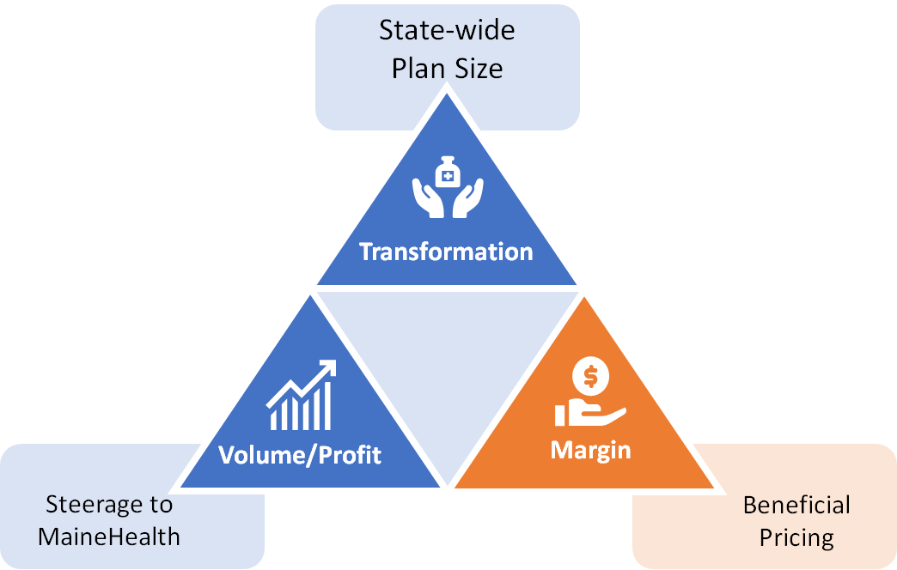
Margin-Focused DTE
Year | Target Employees | Target Members
1 | 100 | 200
2 | 200 | 400
3 | 300 | 500
4 | 400 | 700
5 | 600 | 1,100
6 | 900 | 1,600
7 | 1,200 | 2,200
8 | 1,600 | 2,900
9 | 2,100 | 3,800
10 | 2,600 | 4,700
11 | 3,300 | 5,900
12 | 4,000 | 7,200
13 | 4,800 | 8,600
14 | 5,500 | 9,900
15 | 6,300 | 11,300
16 | 6,900 | 12,400
17 | 7,500 | 13,500
18 | 8,000 | 14,400
19 | 8,400 | 15,100
20 | 8,700 | 15,700
21 | 8,900 | 16,000
22 | 9,100 | 16,400
23 | 9,200 | 16,600
24 | 9,300 | 16,700
25 | 9,400 | 16,900
Early Stage
Gaining Name Recognition, Early Growth
New Revenue:
New Profit:
$2.55M
$0.37M
Growth Stage
Strong Reputation, Strong Growth
New Revenue:
New Profit:
$17.78M
$3.75M
Mature Stage
High Profitability, Market Saturation
New Revenue:
New Profit:
$35.42M
$7.63M

Slide 6
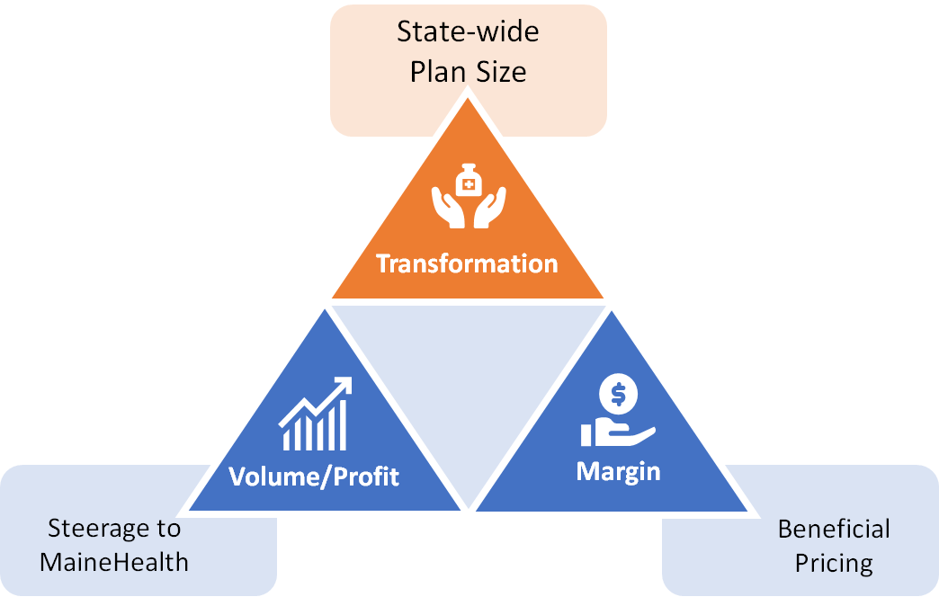
State-Wide DTE
Early Stage
Gaining Name Recognition, Early Growth
Year | Employees | Members
1 | 9,100 | 20,020
2 | 18,300 | 40,260
3 | 27,600 | 60,720
4 | 38,200 | 84,040
5 | 49,600 | 109,120
6 | 61,300 | 134,860
7 | 72,900 | 160,380
8 | 83,600 | 183,920
9 | 93,200 | 205,040
10 | 101,400 | 223,080
New Revenue:
New Profit:
$0M
$0M
Growth Stage
Strong Reputation, Strong Growth
New Revenue:
New Profit:
$0M
$0M
Mature Stage
High Profitability, Market Saturation
Target of reaching 20% of the population in 10 years.
New Revenue:
New Profit:
$0M
$0M

Slide 7
Other Insights

Slide 8
Companies by County
Companies Headquartered by County With 50+ Employees
75
22
46
164
28
29
57
144
39
60
117
43
65
568
42
182
Number of Companies
100
200
300
400
500

Slide 9
Companies with 50-200 Employees
Companies with 50-200 Employees
60
17
35
119
23
22
45
104
33
48
89
37
52
428
34
148
Number of Companies
100
200
300
400

Slide 10
Companies with 201-500 Employees
Companies with 201-500 Employees
13
4
7
26
2
7
6
30
5
9
18
3
10
100
7
25
Number of Companies
25
50
75
100

Slide 11
Companies with 501-1000 Employees
Companies with 501-1000 Employees
2
1
2
14
2
0
2
8
1
0
8
2
2
27
0
7
Number of Companies
0
5
10
15
20
25

Slide 12
Companies with 1001-3000 Employees
Companies with 1001-3000 Employees
0
0
1
4
0
0
2
1
0
3
2
1
1
8
0
2
Number of Companies
0
2
4
6
8

Slide 13
Companies with 3001+ Employees
Companies with 3001+ Employees
0
0
1
1
1
0
2
1
0
0
0
0
0
5
1
0
Number of Companies
0
1
2
3
4
5

Slide 14
Total Employees in Maine Counties
Total Employees at Companies with 50+ Employees
13,550
4,275
14,325
42,475
8,548
5,200
16,525
31,500
6,625
15,150
27,425
9,175
13,500
124,750
13,000
36,500
Number of Employees
25,000
100,000

Slide 15
Employees in Companies with 50-200 Employees
Employees in Smaller Companies with 50-200 Employees
7,500
2,125
4,375
14,875
2,875
2,750
5,625
13,000
4,125
6,000
11,125
6,500
53,500
4,250
4,625
18,500
Number of Employees
10,000
20,000
30,000
40,000
50,000

Slide 16
Employees in Companies with 201-500 Employees
Employees in Medium-Sized Companies with 201-500 Employees
4,550
1,400
2,450
9,100
700
2,450
2,100
10,500
1,750
3,150
6,300
3,500
35,000
2,450
1,050
8,750
Number of Employees
10,000
20,000
30,000

Slide 17
Employees in Companies with 501-1000 Employees
Employees in Medium-Large Companies with 501-1000 Employees
1,500
750
1,500
10,500
1,500
0
1,500
6,000
750
0
6,000
1,500
20,250
0
1,500
5,250
Number of Employees
0
5,000
10,000
15,000
20,000

Slide 18
Employees in Companies with 1001-3000 Employees
Employees in Large Companies with 1001-3000 Employees
0
0
2,000
8,000
0
0
4,000
2,000
0
6,000
4,000
2,000
16,000
0
2,000
4,000
Number of Employees
0
4,000
8,000
12,000
16,000

Slide 19
Employees in Companies with 3001+ Employees
Employees in Very Large Companies with 3001+ Employees (Excluding Health Systems)
0
0
4,000
0
3,473
0
3,300
0
0
0
0
0
0
0
6,300
0
Number of Employees
0
2,000
4,000
6,000

Slide 20
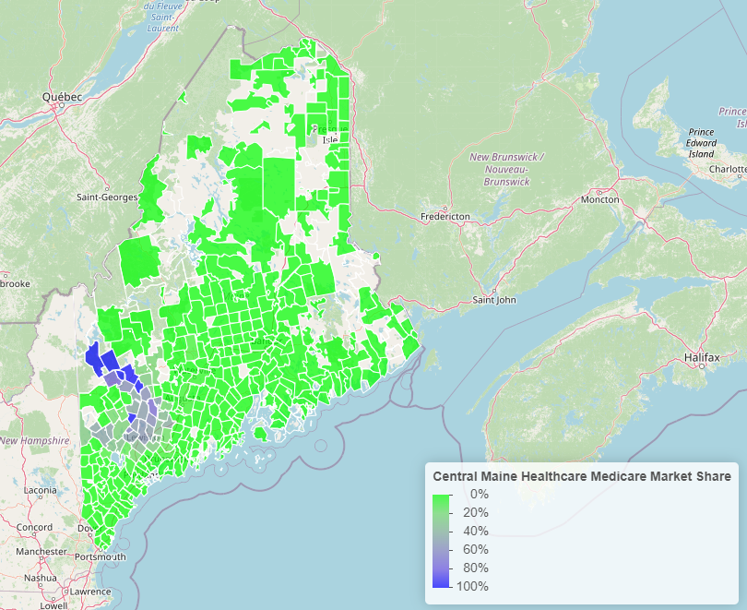
Central Maine Market Share

Slide 21
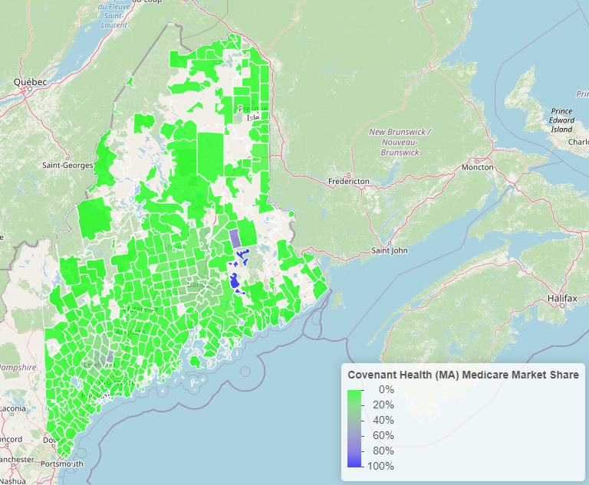
Covenant Health Market Share

Slide 22
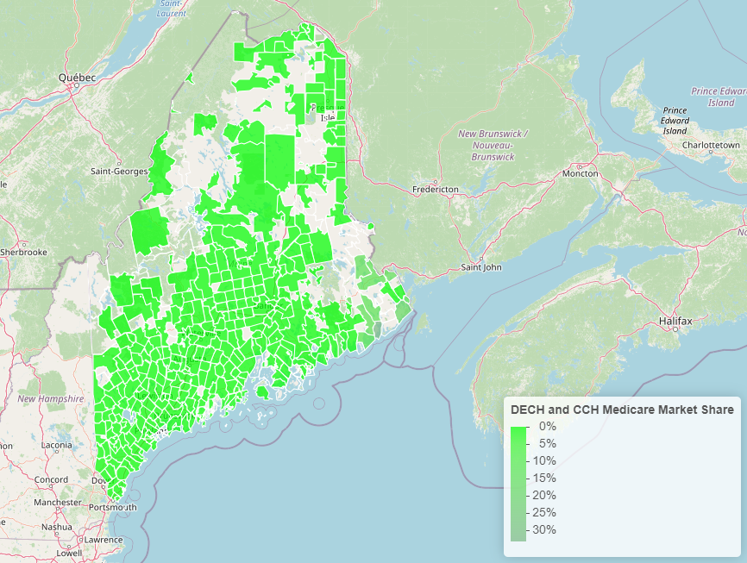
DECH and CCH Market Share

Slide 23
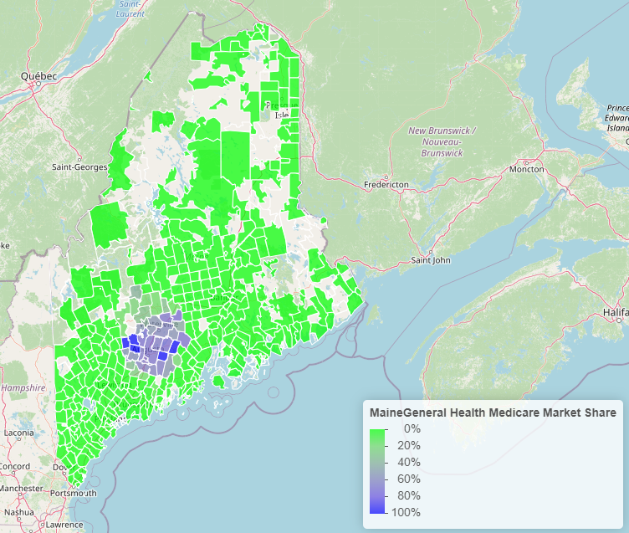
Maine General Market Share

Slide 24
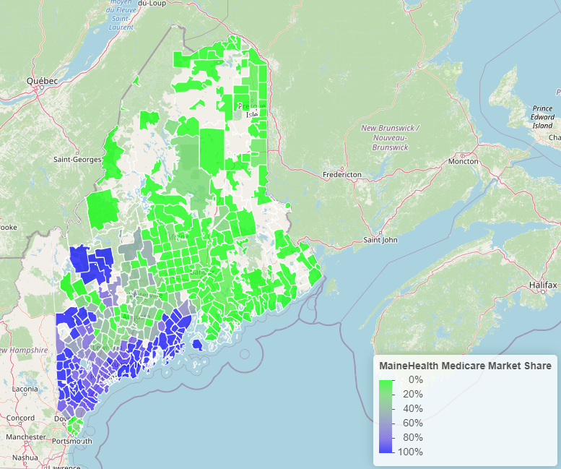
MaineHealth Market Share

Slide 25
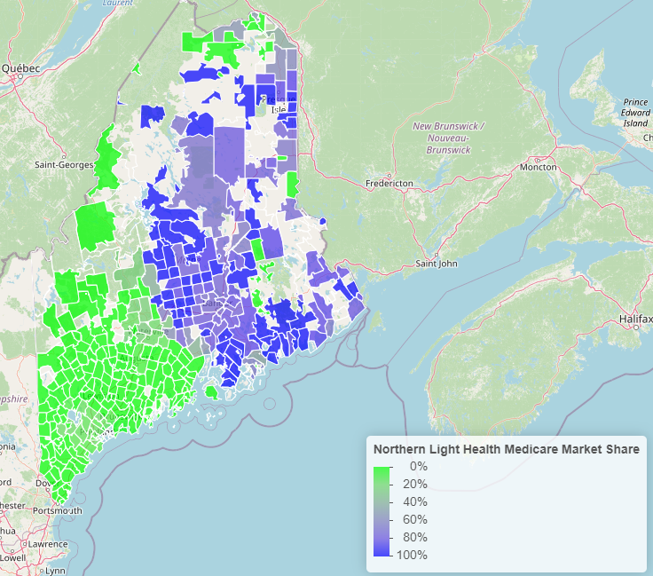
Northern Light Market Share

Slide 26
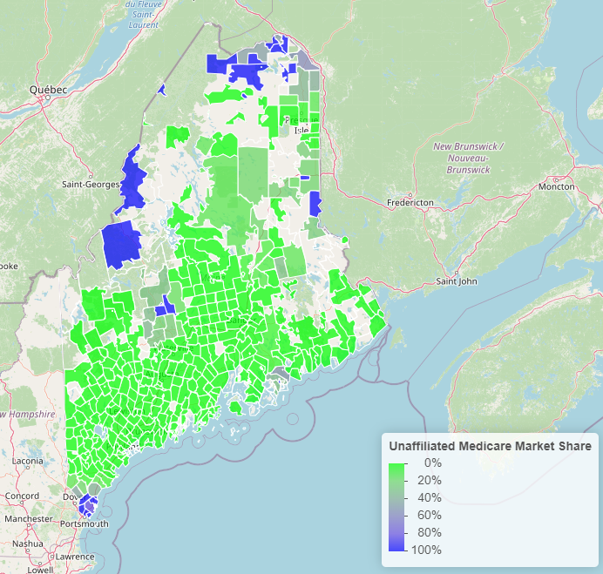
Unaffiliated Health Systems Market Share

